Slide 1



Software Development and Professional Practices
Web Development

Slide 2
Objectives
Installing and running Apache Tomcat webserver and Eclipse
Installing and running ASP.NET core

Slide 3


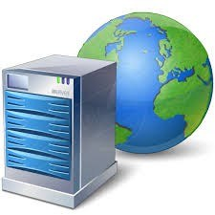
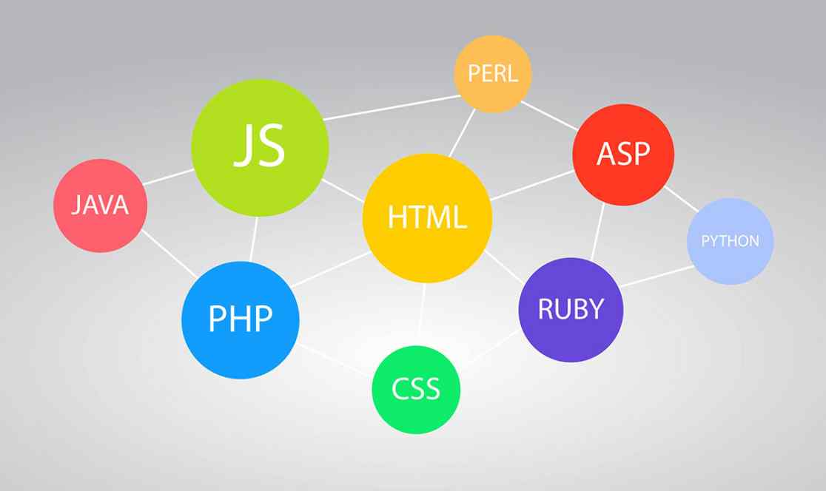
Web Development
A web stack refers to the technologies and components used to create and serve web content. At the very minimum, it contains:
an operating system
a web server technology
a database
frontend and backend programming languages

Slide 4
Web Development
Web Solution Stacks
LAMP
WISA
Linux
Apache
MySQL
PHP
Windows
IIS
SQL Server
ASP
Common Solutions:

Slide 5
Installing Apache Tomcat
Apache Tomcat and Eclipse
ASP.NET

Slide 6
Installing Apache Tomcat
Apache Tomcat is an open-source web server technology made specific for Java and Java Servlets.
A web server is a program that serves web content via Hypertext Transfer Protocol (HTTP) from a server to a client (e.g., your browser).
Servlets are the Java programs that runs on the Java-enabled web server or application server.
Download Apache Tomcat 9 from here http://tomcat.apache.org/

Slide 7
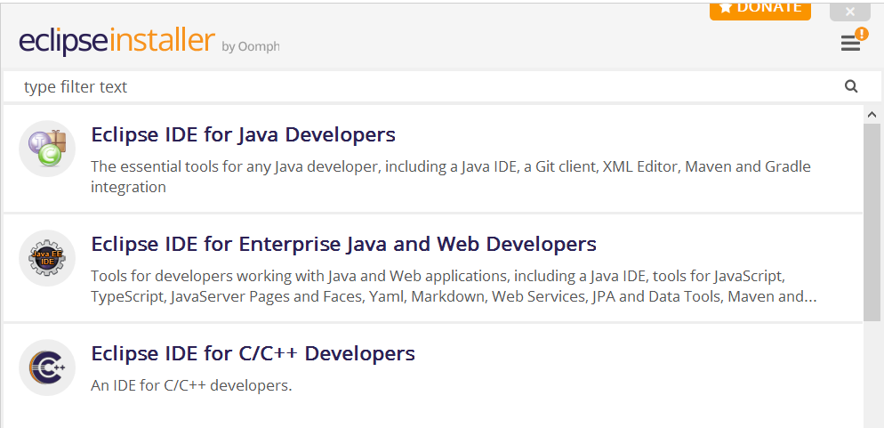
Installing Eclipse
Download Eclipse IDE from here https://www.eclipse.org/
Run eclipse for web development

Slide 8
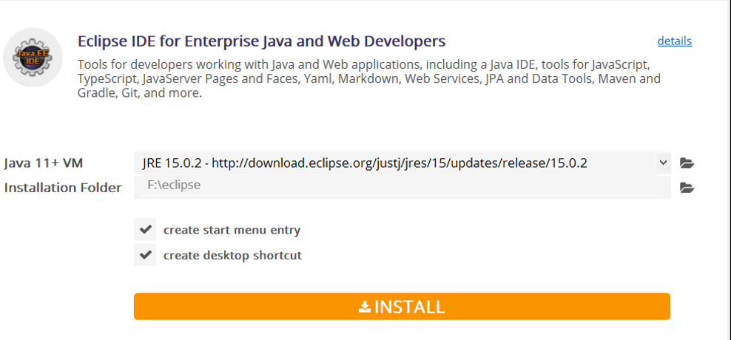
Installing Eclipse
Set the installation folder and then click INSTALL

Slide 9
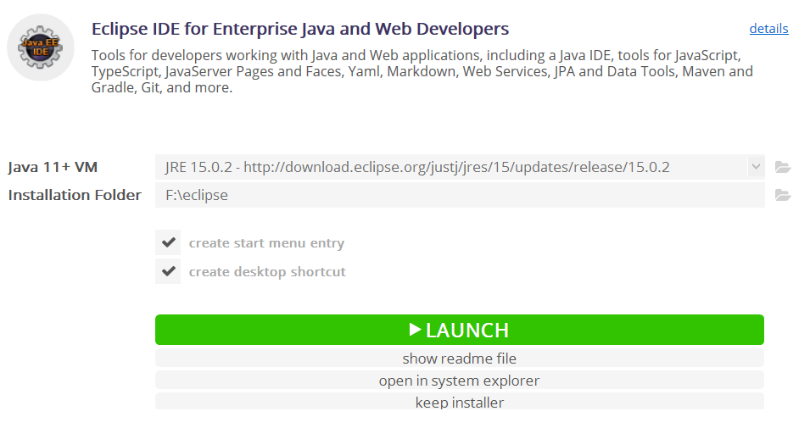
Installing Eclipse
Click LAUNCH

Slide 10
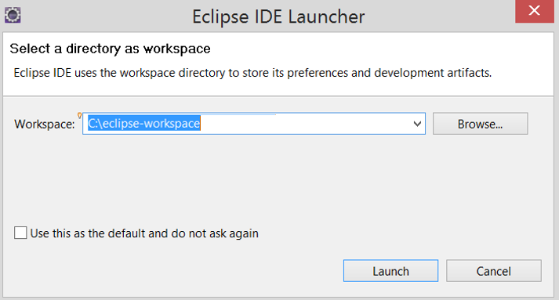
Running Eclipse
Choose the workspace directory and then click Launch

Slide 11
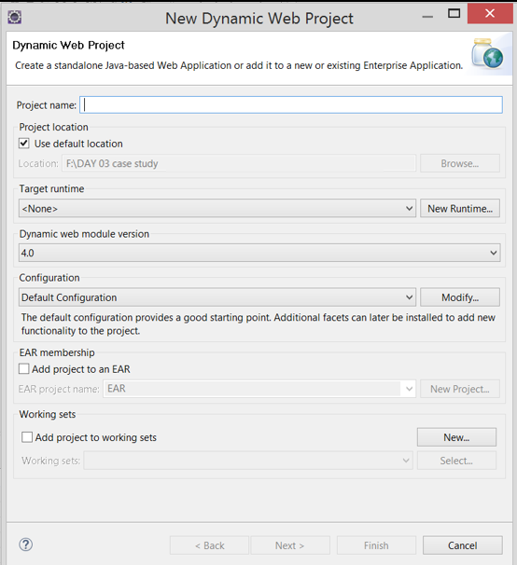
Running Eclipse
Create a new dynamic web project:
File > New > Dynamic Web Project
Enter Project Name
Use or change the default location

Slide 12
Running Eclipse
Create a new dynamic web project:
File > New > Dynamic Web Project
Enter Project Name
Use or change the default location
Click on New Runtime

Slide 13
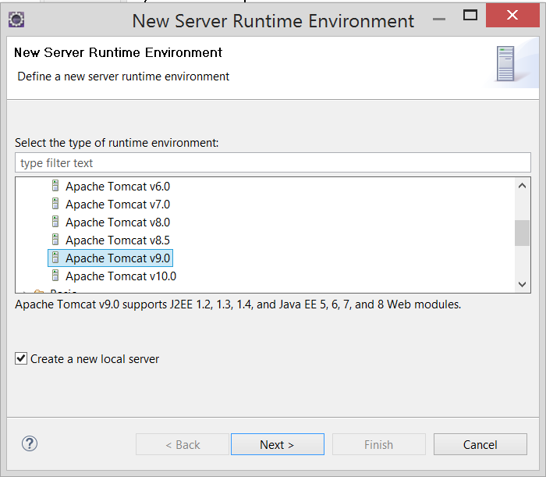
Running Eclipse
Create a new dynamic web project:
File > New > Dynamic Web Project
Enter Project Name
Use or change the default location
Click on New Runtime
Select Apache Tomcat v9.0
Check on Create a new local server
Click Next

Slide 14
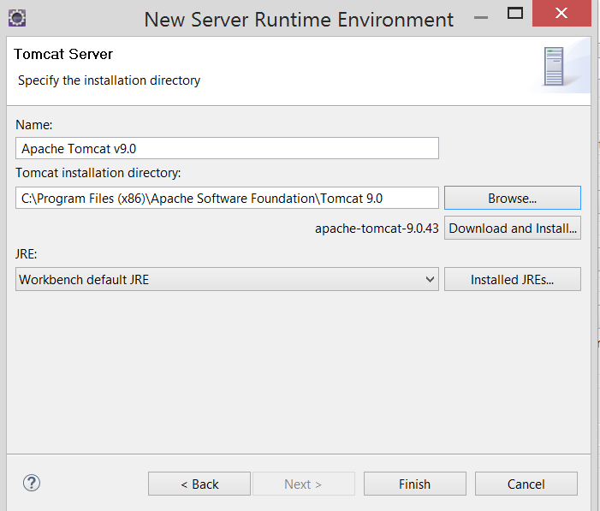
Running Eclipse
Create a new dynamic web project:
File > New > Dynamic Web Project
Enter Project Name
Use or change the default location
Click on New Runtime
Select Apache Tomcat v9.0
Check on Create a new local server
Click Next
Set the directory of the Tomcat server
Click Finish

Slide 15
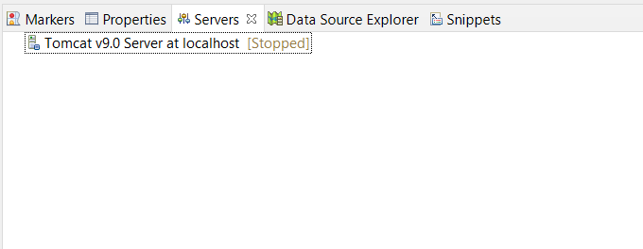
Running Eclipse
Start your server:
Switch to Servers tab
Right-click on the server, choose Start

Slide 16
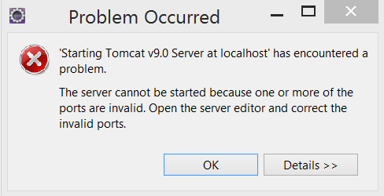
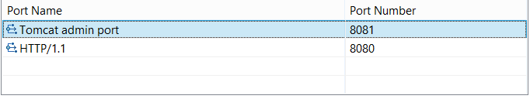
Running Eclipse
If you have an error like this:
Click on OK
Double-click on server
Change Tomcat admin port to 8081
Save and run again

Slide 17
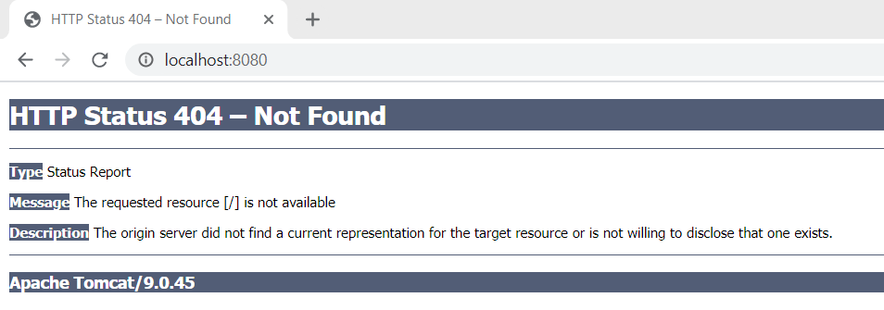
Running Eclipse
Test if the server is running:
Open your browser
Navigate to localhost:8080
If the server is working, you will get an error page

Slide 18
Running Eclipse
Replace 404 message with a default static website
Navigate to Apache Software Foundation/Tomcat 9.0/webapps
Copy the ROOT folder.
Now navigate to: your_eclipse_workspace/.metadata/.plugins/org.eclipse.wst.server.core/tmp0/wtpwebapps and paste the ROOT folder you just copied.
Restart Tomcat from within Eclipse (Stop it and then Start it).
Now open your web browser and type localhost:8080. You should now see Tomcat’s default page.

Slide 19
Running Eclipse
Add custom HTML page
Right-click on src/webapp directory
Click New > HTML File
Edit the HTML file
Save and run

Slide 20
Installing Apache Tomcat
Apache Tomcat and Eclipse
ASP.NET

Slide 21
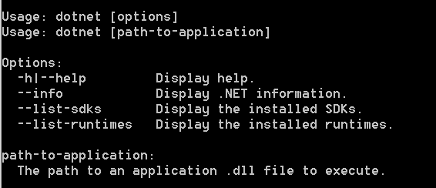
ASP.NET
Download .NET SDK 5.0 from here https://dotnet.microsoft.com/download/visual-studio-sdks
Check everything installed correctly
Open cmd
Run the command: dotnet
If the installation succeeded, you should see an output like the following:

Slide 22
ASP.NET
To create a new web app, run the command: dotnet new webApp -o helloWorld --no-https
The webApp parameter selects what template to use when creating your app.
The -o parameter creates a directory named helloWorld where your app is stored.
The --no-https flag specifies not to enable HTTPS.
Navigate to the new directory created by the previous command: cd myWebApp

Slide 23
ASP.NET
Current files
startup.cs contains the app startup code and middleware configuration.
The helloworld/Pages directory contains some example web pages for the application.
helloworld.csproj defines what libraries are referenced etc.
Run the app: dotnet watch run
This run command will build and start the app, and then rebuild and restart the app whenever you make code changes.
Go to http://localhost:5000

Slide 24
ASP.NET
Edit the web page:
Open Pages/Index.cshtml in any text editor and replace all the code with the following, then save the file.
@page
@model IndexModel
@{
ViewData["Title"] = “First ASP web page";
}
<div class="text-center">
<h1>Welcome to ASP.NET</h1>
<p>The time on the server is @DateTime.Now</p>
</div>

